Slide 1
PRE-ENROLMENT 2022
THE BLUE COAT SIXTH FORM

Slide 2
AIMS OF TODAY

Slide 3
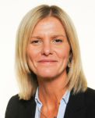
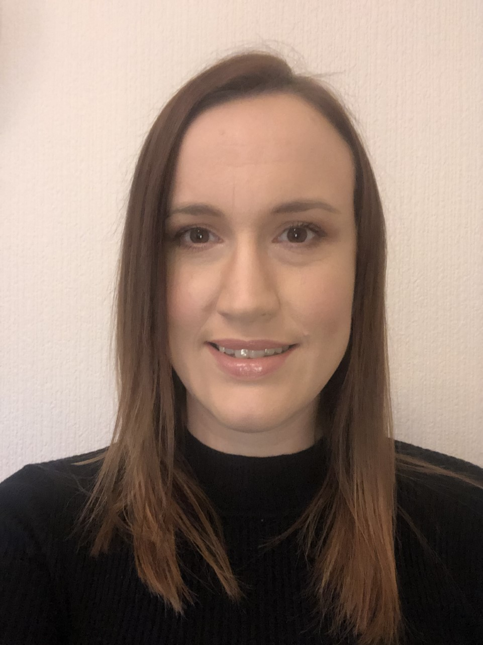
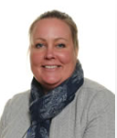
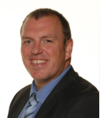
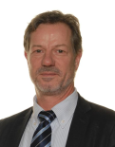
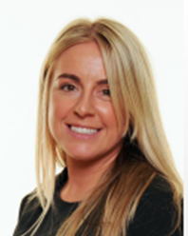
The Blue Coat Sixth Form Team
Mrs Tipler
Deputy Headteacher
Director of Sixth Form
Miss Barnes
Assistant Headteacher
Head of Sixth Form
Miss Elliott
Director of Learning
Year 12
Mr Wild
Pastoral Mentor
Attendance and Wellbeing
Mr Lowe
Academic Mentor
ILC Manager
Miss Richardson
Director of Learning
Year 13
Notes:
JBR - team

Slide 4
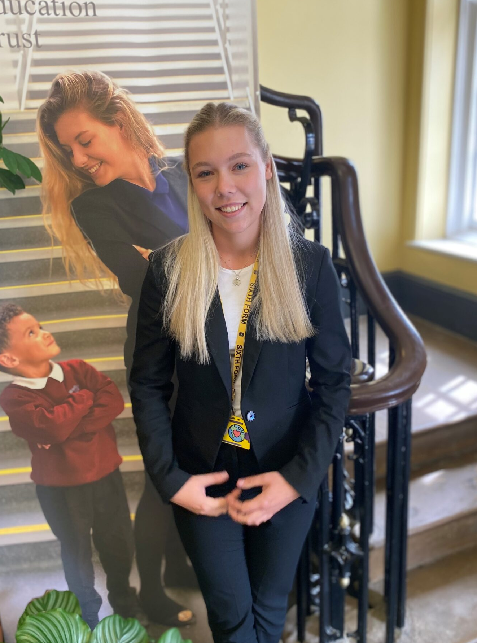
Head Girl & Boy

Slide 5
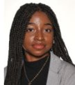
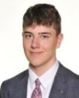
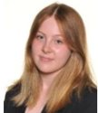
Deputy Head Students: Community & Cohesion
Notes:
DG/JB/EG
Picture of each
Introductions /subjects chosen/future ambition
Multi-faith, multi-ethnic, multi-talented
Joint Year 12 & 13 tutor groups on a Friday – Quiz/competitions
Charity

Slide 6
Form Tutor Session
Room | Tutor | Tables
BC01 | Mrs Knott | 1, 2, half of 21
BC02 | Mrs Prince | 3, 4, half of 21
BC03 | Mrs Lawson | 5, 6, half of 22
BC04 | Miss Taylor | 7, 8, half of 22
BC05 | Miss Hennessy | 9, 10, half of 23
BC06 | Mr Casey | 11, 12, half of 23
BC07 | Mrs Sayer | 13, 14, half of 24
BC15 | Ms Savazzi | 15, 16, half of 24
BC16 | Miss Wood | 17, 18, half of 25
BC17 | Dr Owen | 19, 20, half of 25

Slide 7
Form Tutor Session

Slide 9
The role of a Form Tutor in our Sixth Form

Slide 10
Dress code: Standard items
We are proud of our students’ smart appearance and have high expectations through our dress code.
Tailored suit jacket | To be worn at all times.
Tailored suit trousers OR Tailored suit skirt OR Tailored suit dress | The trousers should match the jacket. The skirt should match the jacket. Stretchy tube skirts and short skirts are not acceptable. The dress must be a suit dress and should match the jacket. Opaque tights are to be worn with skirts and dresses.
Shirt and tie or Blouse | The top must cover the shoulders, cleavage and midriff. Polo shirts and T-shirts are not acceptable.
Smart shoes | Trainers and Doc Marten boots are not acceptable, although Doc Marten shoes are.
Sixth Form lanyard | To be worn at all times around the neck when on the school site.

Slide 11
Dress code: Optional items
We are proud of our students’ smart appearance and have high expectations through our dress code.
Plain, smart jumper or cardigan | Only to be worn in addition to the standard items above. Hoodies and sweatshirts are not acceptable.
Hijab | Must be plain colour and fitted securely. All students must be facially identifiable at all times.

Slide 12
Dress code: Other
We are proud of our students’ smart appearance and have high expectations through our dress code.
Hair and makeup | Should be discrete. Extreme hair colours are not acceptable. False nails are acceptable.
Jewellery | Should be discrete. A single nose stud is acceptable, nose rings are not.
Tattoos | Should be covered up at all times.

Slide 14
PRE-ENROLMENT 2022
THE BLUE COAT SIXTH FORM

Slide 15
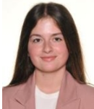
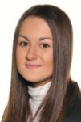
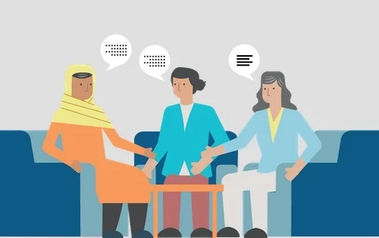
Deputy Head Students: Guidance & Support
What we study and our future aspirations
Futures Pathway: Pre U, Core Maths, Physics, Further Maths, Music, French or German
Subject mentoring and support
ILCs and study periods
General life as a sixth former
Notes:
SK & CW
Picture of each
Introductions /subjects chosen/future ambition
Use of ILC
Type of day – typical timetable
Futures Pathway
3 subjects Mentoring for next year? What will this look like.

Slide 16
Pathways
Notes:
JBR
US:
MDV
Oxbridge
Ultimate products/Business

Slide 17
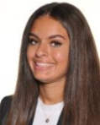
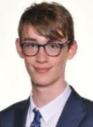
Deputy Head Students: Wellbeing & Welfare
Relationships with Form Tutors and Subject Teachers
Fortnightly Wellbeing Lessons
Fortnightly Lectures
Student Voice
Notes:
SW & EP
Picture of each
Introductions /subjects chosen/future ambition
Relationship with Form Tutor and subject teachers – why this important, how good this is at BC
Personal development / pastoral curriculum (what happens in wellbeing & lecture – how this supports you, examples)
Student voice – working with Dol/Head of Sixth

Slide 18
Support
Notes:
JBR
Bursary
Social Mobility
Talent Tap
Uniq
Access Programmes
Sutton trust

Slide 19
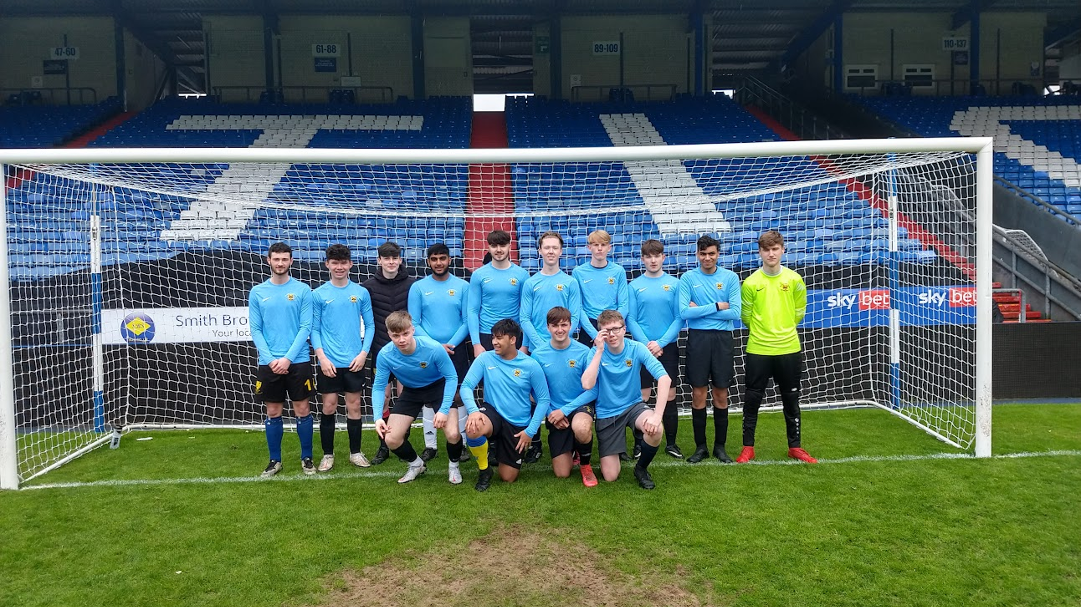
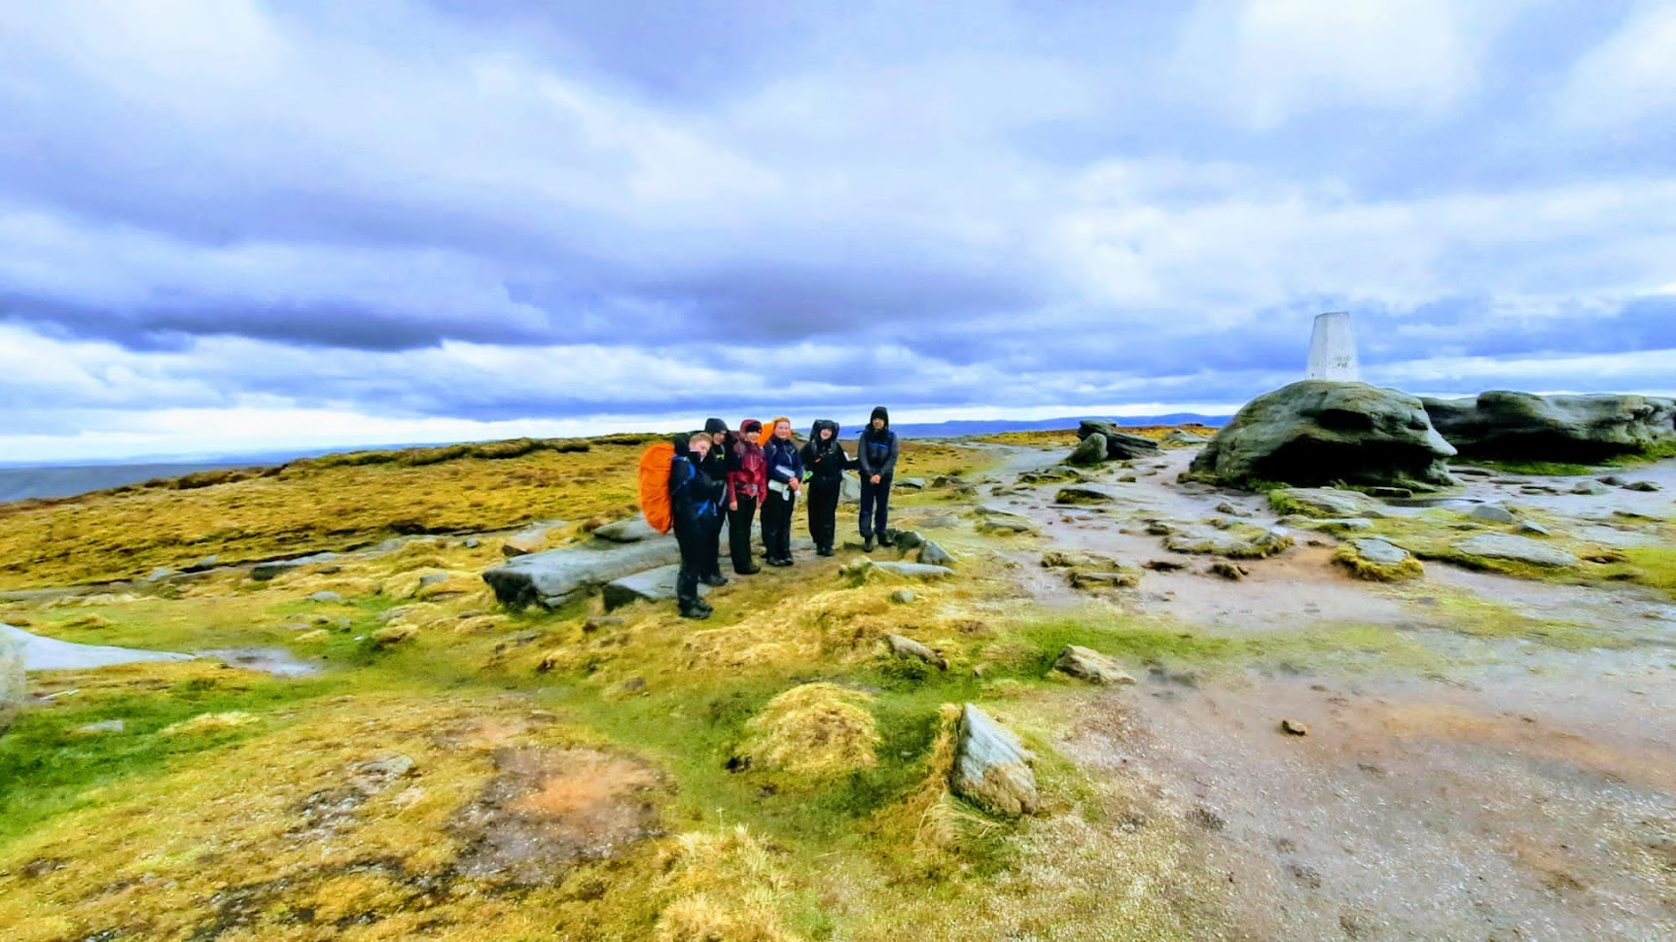
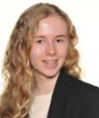
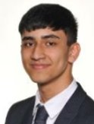
Extracurricular and Cocurricular

Slide 20
What Next: Subject Tasters
8.50am to 1.10pm
via Teams
GCSE to A-level
Ask Qs
Bridging work
Subject introduction
45 mins
4th & 5th July
Notes:
HEL
Dates/times/access via Teams

Slide 21
What Next: Subject Tasters
https://sixthform.blue-coat.org/pre-enrolment-events-programme-2022/
Notes:
HEL

Slide 22
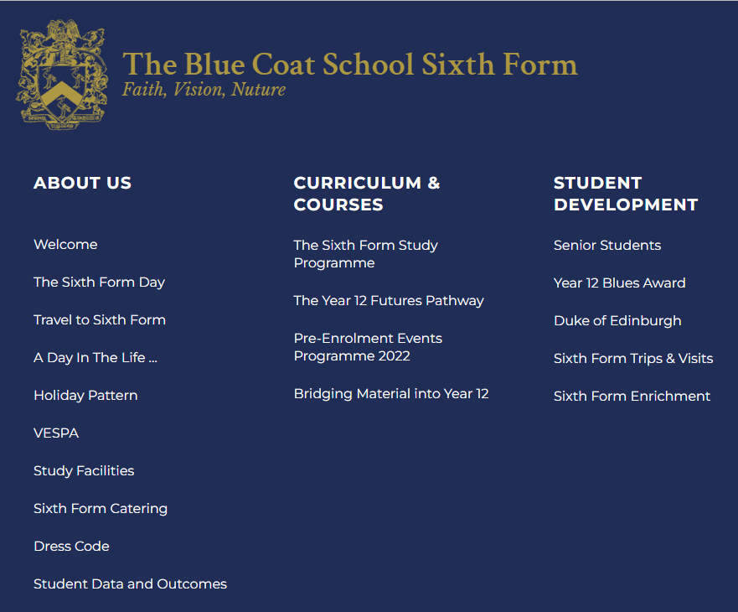
Notes:
HEL

Slide 23
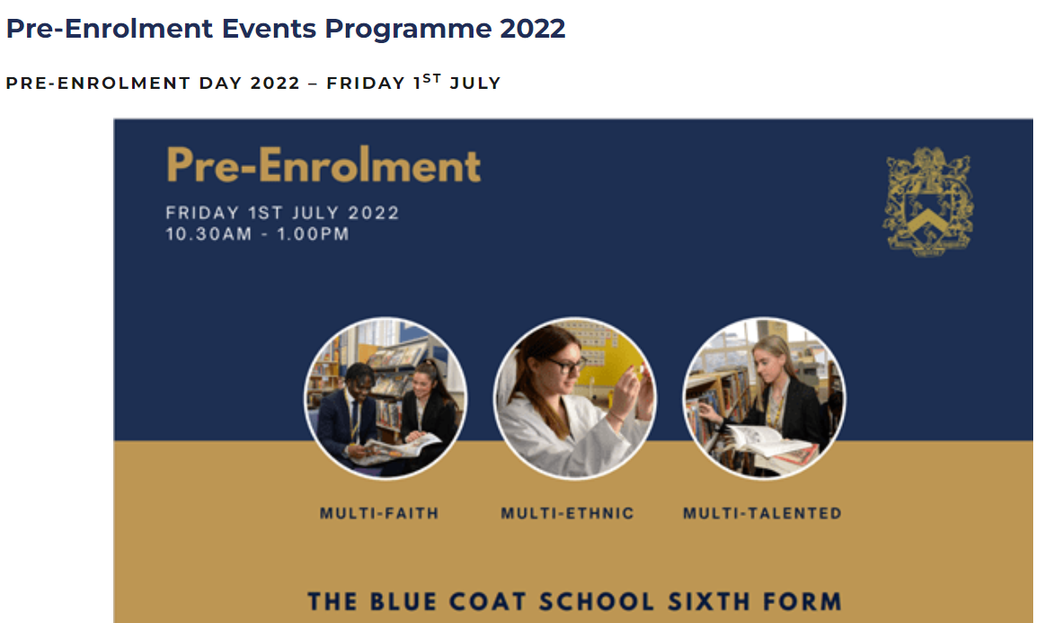
Notes:
HEL

Slide 24
Notes:
HEL

Slide 25
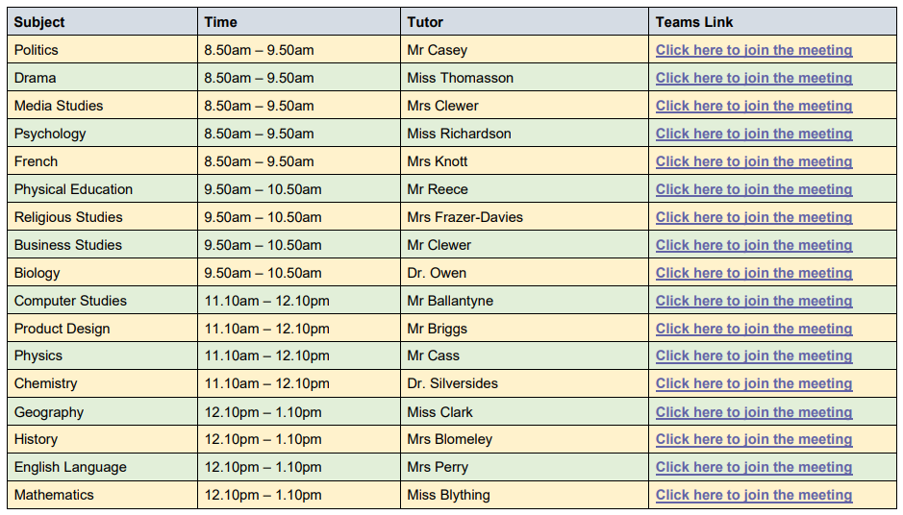
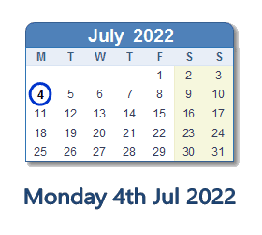

Slide 26
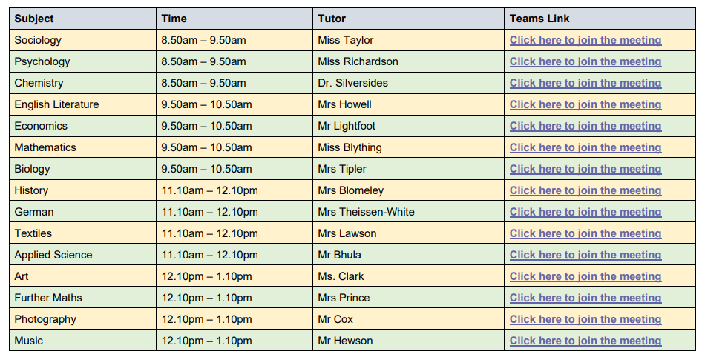
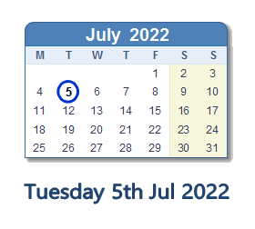

Slide 27
What Next: Bridging work
Work we ask you to complete over the summer
Gives a taster of what studying your subjects will be like at A-level
Helps with the step-up from GCSE to A-level
Gives teachers an indication of how you work
Notes:
HEL

Slide 28
What Next: Bridging work
https://sixthform.blue-coat.org/year-11/
Notes:
HEL

Slide 29
Notes:
HEL

Slide 30
Notes:
HEL

Slide 31
Notes:
HEL

Slide 32
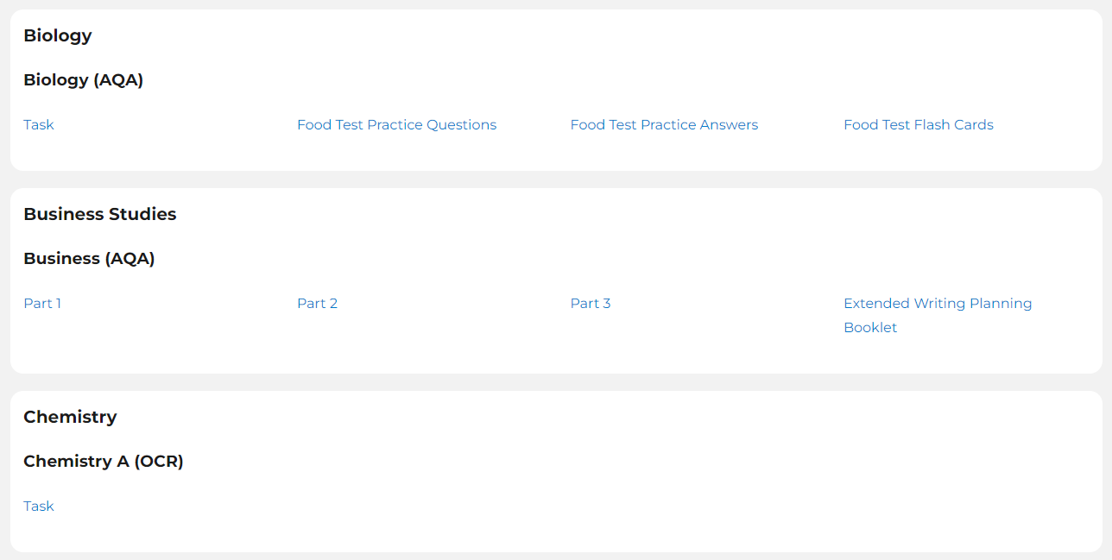
Notes:
HEL

Slide 33
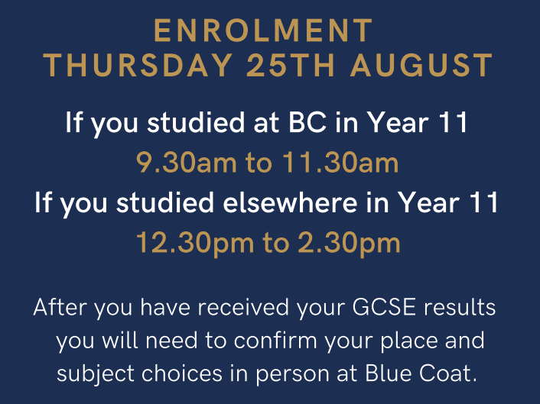
What Next: Results & Enrolment
Notes:
HEL
Dates/times/venue
Change of subject will be picked up at enrolment
Currently finalising timetables – if there are any issue we will be in touch with you next week. CLASHES

Slide 34
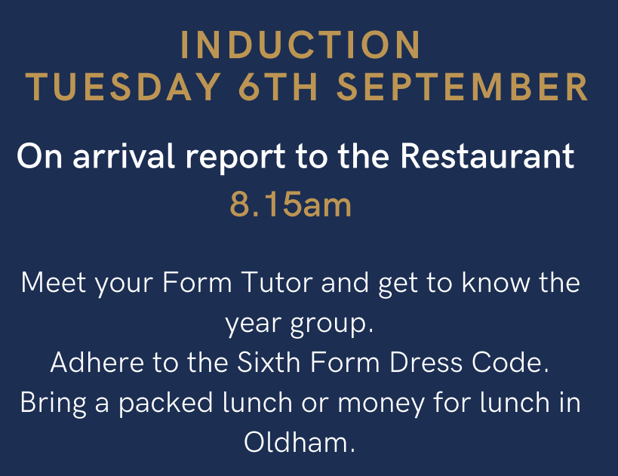
What Next: Induction
Notes:
HEL
Dates/times/venue
Structure of day
Wear dress code
Money

Slide 35
What Next: Induction Trip
To create a strong year group by forming bonds and connections.
To encourage collaboration and teamwork.
To develop trust, improve communication and increase motivation.
To promote mindfulness and wellbeing.
Notes:
HEL

Slide 36
What Next: Induction Trip
16th Sept
To create a strong year group by forming bonds and connections.
To encourage collaboration and teamwork.
To develop trust, improve communication and increase motivation.
To promote mindfulness and wellbeing.
Notes:
HEL

Slide 37
What Next: Induction Trip
16th Sept
£40
To create a strong year group by forming bonds and connections.
To encourage collaboration and teamwork.
To develop trust, improve communication and increase motivation.
To promote mindfulness and wellbeing.
Notes:
HEL

Slide 38
Social Media
@BCOldham6thForm
Notes:
HEL

Slide 39
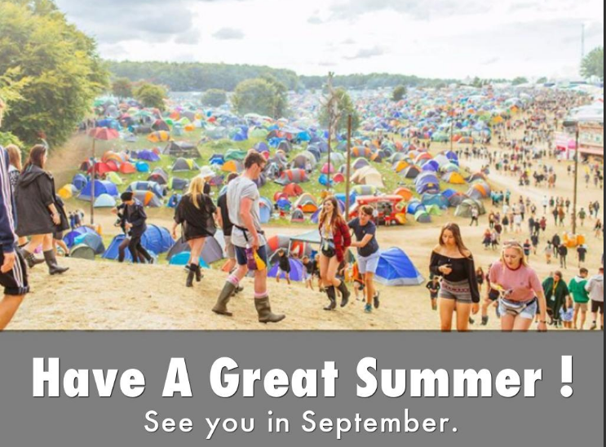
Notes:
JTI

