Slide 1
“Sociology may be defined as the study of society; that is of the web of human interactions and relationships”.
A-Level Sociology
In this session:
Outline of the course
What you can do with Sociology
Successes and destinations
Student voice

Slide 2
What is Sociology?
Notes:
Sociologists are interested in using research methods to study patterns and trends in society and behaviour so they can make generalisations such as ‘Lone parent families create criminals’
‘Girls are more likely to do better at school’
‘ There is a link between low literacy levels and drug taking’
Some other interesting questions we tackle are…

Slide 3
Course Outline
Year 1:
Families & households
Education and methods in context: You’ll consider the role of education in society. For example as part of your studies you’ll look into gender and ethnicity differences in school achievement. You’ll also learn how to apply your own sociology research methods to the study of education.
Research methods: You’ll learn how to conduct your own sociological research, from interviews to reviewing documents and official statistics.
Year 2:
Beliefs
Crime and deviance with theory and methods: You’ll learn about criminal and deviant behaviour, including factors that might lead a person to follow this path in life and how the media portrays them
Theory and methods: you’ll expand on your knowledge of research methods and study theory and methods.
What skills will I learn?
Our A-Level Sociology course will help you develop a range of skills that will benefit you, whether you decide to go on to further study or the working world, including;
The use of evidence to support your arguments
How to investigate facts and use deduction
Critical thinking
Making reasoned arguments
Developing opinions and new ideas on societal issues
The ability to analyse and better understand societal issues.

Slide 4
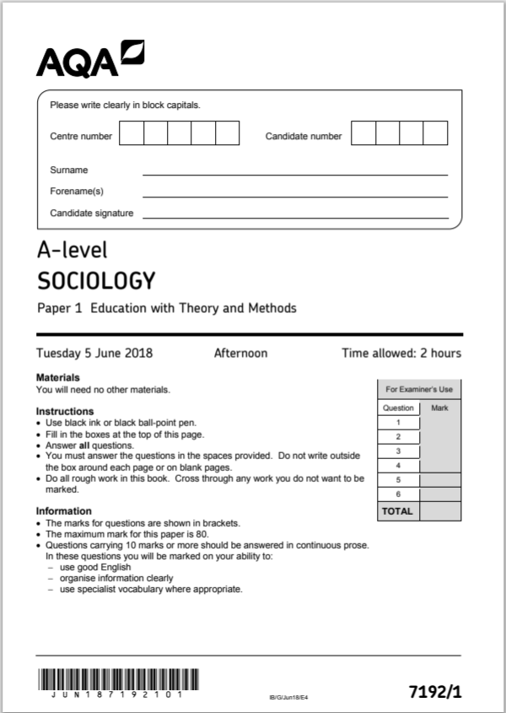
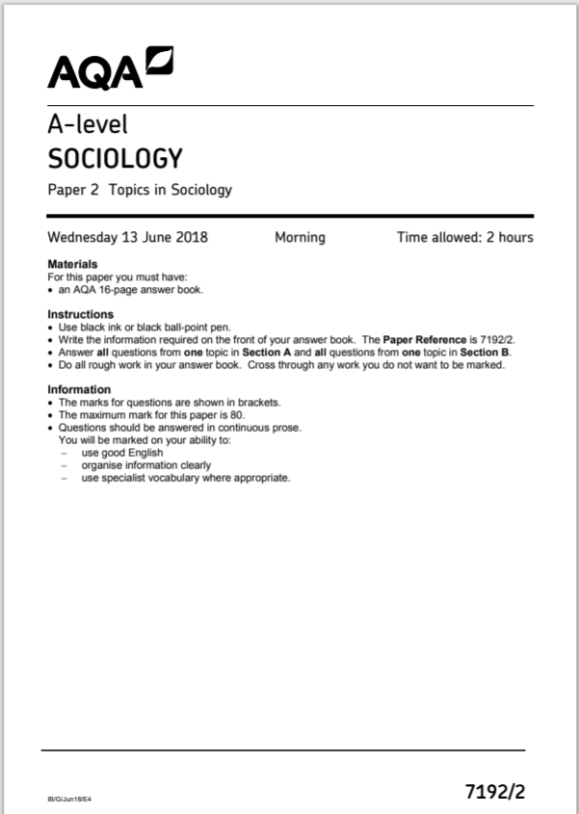
Exam information/Entry requirements
5 GCSEs at grade 6 or above in different subjects including English and Maths. The course is largely essay based so strong writing skills are essential.

Slide 5
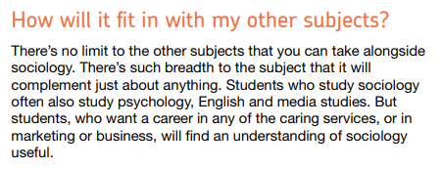
Why study Sociology?

Slide 6
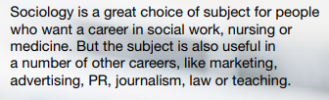
Future prospects
Career options
Where will A level Sociology take you?

Slide 7
Destinations for Sociology students
Niamh achieved an A* - University of Newcastle to study Psychology
Haidee achieved and A*- University of Leeds to study International Politics and History
Zoe achieved and A*- University of Durham to study English Literature
Billy achieved an A - University of Leeds to study History and Sociology
Richard achieved an A - University of Warwick to study Law
Elizabeth achieved an A - University of Leeds to study Philosophy, Ethics and Religion
Katie achieved an A- University of Liverpool to study Diagnostic Radiography

Slide 8
Student Voice
Sociology is a very interesting subject, I want to study criminology at university and sociology really helps with this.
I study sociology because I like learning about sociological perspectives of society as a whole and learning about how it is structured.
I really enjoy doing a brand new subject. Its so interesting and has made me more insightful.
I chose to study sociology because I’m interested in how society works. It has led me to want to study a degree in law with Criminology.
I took sociology at A-Level because I needed to broaden my knowledge of the world.
The subject is really interesting. We learn about different perspectives and have interesting debates.
We get to see other people’s viewpoints and analyse the changes in society.

