Slide 1
Welcome to English Literature

Slide 2
Why study English Literature?
Literature helps us make sense of the world
You get 6 subjects for the price of one
It shows you how to view and interpret things through different lenses and experiences
Provides you with creativity, freedom of expression and sharpens your opinions and critical interpretations
The subject is held in very high regard by universities

Slide 3
Welcome to the Roaring Twenties!
““That’s the best thing a girl can be in this world – a beautiful little fool.”
““He smiled understandingly--much more than understandingly. It was one of those rare smiles with a quality of eternal reassurance in it, that you may come across four or five times in life.”

Slide 4
New Orleans 1947
“They told me to take a street-car named Desire, and transfer to one called Cemeteries, and ride six blocks and get off at—Elysian Fields!”
“You can always rely on the kindness of strangers!”

Slide 5
Step back to 1846 and join tempestuous lovers Cathy and Heathcliff for a walk across the brutal Yorkshire moors
“He’s more myself than I am! Whatever souls are made of, his and mine are the same”
“Be with me always! Take any form! Only do not leave me in this abyss where I cannot find you!”

Slide 6
Arrive in Renaissance Venice,1607
“Reputation, reputation, reputation! O, I have lost my reputation! I have lost the immortal part of myself, and what remains is bestial!”
“O beware my lord of jealousy, it is the green eyed monster which doth mock the meat it feeds on”

Slide 7
Experience 30 years of life in Kabul, from the 1970s to 2003.
“You see, some things I can teach you. Some you learn from books. But there are things that, well, you have to see and feel.”
“Learn this now and learn it well. Like a compass facing north, a man’s accusing finger always finds a woman. Always. You remember that, Mariam.”

Slide 8
What will you study? (EDEXCEL A Level Literature)
Coursework: The Great Gatsby compared with a text of your choosing
A Streetcar Named Desire
A selection of poems from The Forward Book of Contemporary Poetry
A selection of poems by Christina Rossetti
Wuthering Heights and A Thousand Splendid Suns
Othello by William Shakespeare

Slide 9
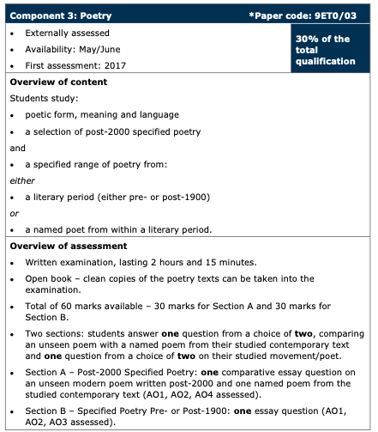
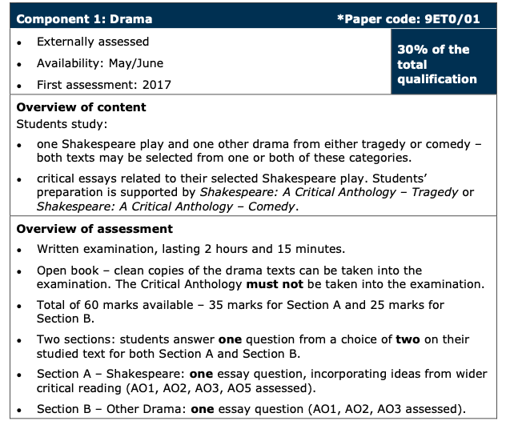
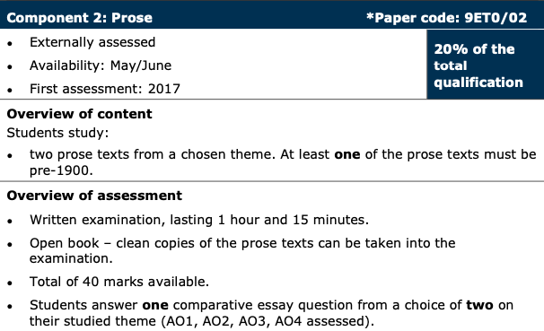
What is the exam like?

Slide 10
What our students say:
Why they chose Lit:
Their expert advice:
What they like:
“I very nearly didn’t pick English lit because I assumed a subject like Maths or History would be preferred when applying to top universities for Medicine. Nonetheless I picked it in the end because upon research I realised how big a part essay writing and eloquent arguments are of higher education no matter what subject you do. English Lit allows you the freedom to learn about philosophy and sociology and history all in the context of your texts but also leaves you with lasting, varied knowledge in the end.”
“I chose English lit because the subject is very complementary to other subjects. As it is an essay based subject it allows you to build up your technique and writing ability as well as allowing you to be creative with your responses and interpretations of the text.”
“I chose English Lit because it balances your subject choices; it's always good to have a creative option that allows you to use your imagination.”
It’s definitely a smart idea to read the texts beforehand and gauge a personal understanding so you’re better able to understand where your own analytical skills are lacking.
One of the best things I did for this subject was read the majority of my texts the summer before year 12 as it gives you a slight head start and better understanding in class. Also, take advantage of anything sixth form organises even if it’s a day long lecture or going to the theatre in the evening – it can make the texts clearer and gives you a running start.
I would advise younger colleagues to begin reading in regular slots at the start of the course, so they don't fall behind on texts. I would also recommend pre-reading the beginning of 'Wuthering Heights' and becoming familiar with the different characters before studying in class as it can become confusing.
“Read the books you get as quickly as possible because then you will understand everything you do properly, and can think about other meanings when you consider the book as a whole.”
“The texts we’ve chosen are so varied but enjoyable nonetheless because our teachers are so lovely!”
“It elevates your writing style and provides a better understanding of how to critically analyse a variety of texts”
“I enjoy the freedom of the subject, there are no right and wrong answers like in Maths, you are able to write your own interpretations as long as you can support it with evidence from the text. I also particularly enjoy reading the modern texts, especially 'A Thousand Splendid Suns’.”
“I enjoy it because it requires you to have outside knowledge, like myths or what different flowers mean- that can be fun!
It makes you think about different interpretations for something that seems simple- that can be useful in everyday life and gives you a perceptive mind.”

Slide 11
Where can Literature take me?

