Slide 1
Studying A-Level Geography

Slide 2
“I am a geographer,” the old gentleman answered.
“What’s a geographer?”
“A geographer is a scientist who knows where the seas are, and rivers, cities, mountains and deserts.”
“That’s very interesting,” said the little prince. “Here at last is a man who has a real job,” he thought.

Slide 3
Who?
What?
Where?
When?
Why?

Slide 4
A facilitating subject…
The Russell Group of leading universities in the UK has designated geography as a ‘facilitating subject.’ These are subjects which allow you to keep your options open for further study. They encompass a broad range of skills that mean you are suited to a wide range of future study options rather than being limited. Essentially, universities highly regard geography A-level.

Slide 5
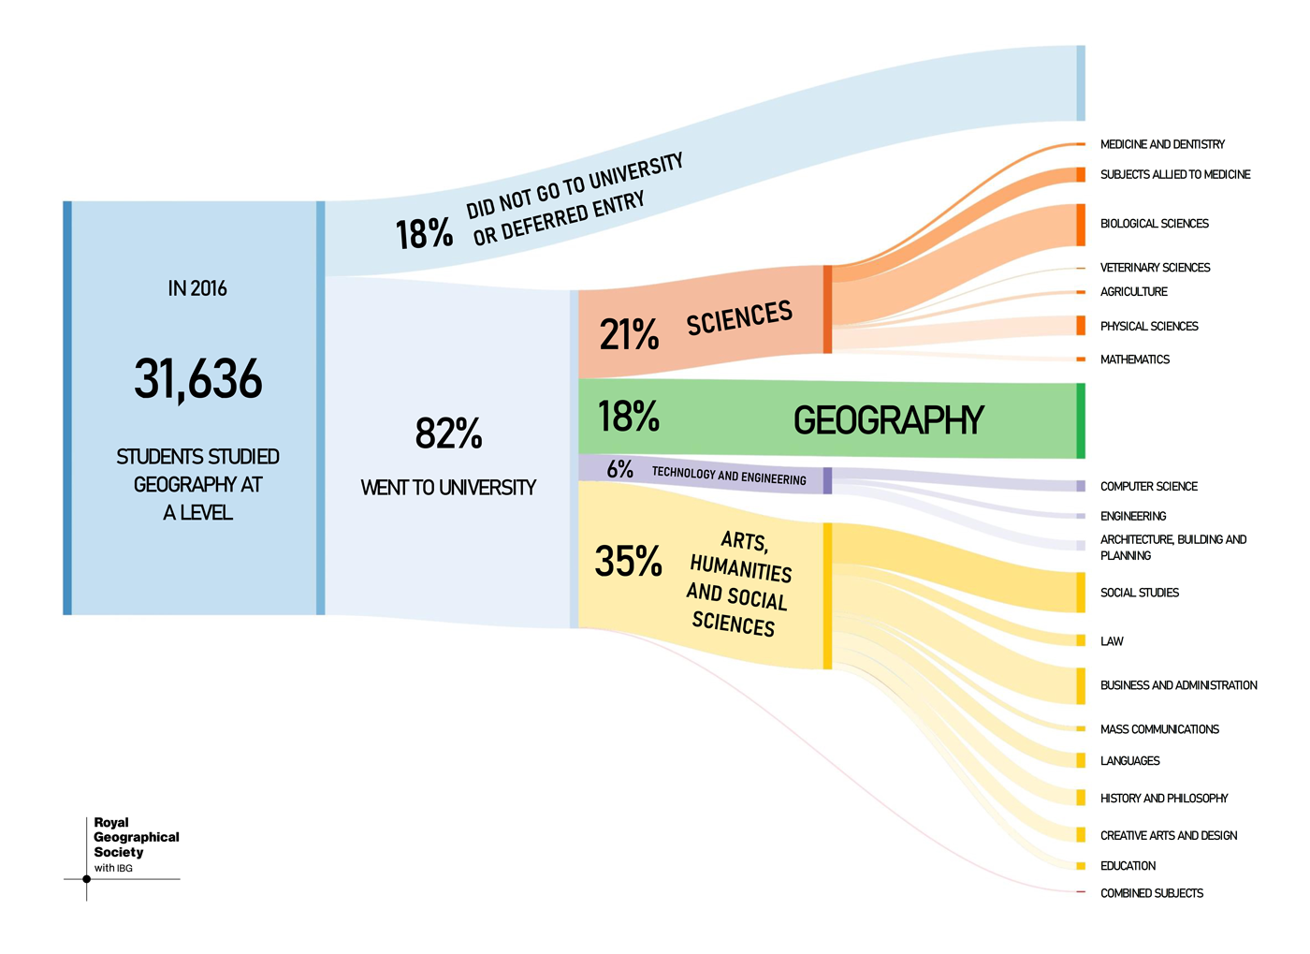

Slide 6
OCR Geography A Level 80% exam, 20% NEA
Paper 1 | Paper 2 | Paper 3 | NEA
Physical Geography Coasts Water and carbon cycles | Human Geography Space and place Migration, power and borders | Geographical Debates Climate change Natural hazards | Your own choice of investigation A 4,500 word piece of coursework that follows a typical enquiry sequence.
You will have a combination of 3 teachers for A-Level Geography:
Mr. Venables
Miss Clark
Miss Sinfield
Miss Gray
We all specialise in certain topics meaning you get a good deal!

Slide 7
Suggested reading…
“Prisoners of Geography” by Tim Marshall
https://www.amazon.co.uk/Prisoners-Geography-Everything-Global-Politics/dp/1783961414
“Factfulness” by Hans Rosling
https://www.amazon.co.uk/Factfulness-Reasons-Wrong-Things-Better-ebook/dp/B0769XK7D6/ref=sr_1_1?dchild=1&keywords=factfulness&qid=1585901768&s=books&sr=1-1
“The North” by Paul Morley.
https://www.amazon.co.uk/North-Almost-Everything/dp/B00IT0Y44Q/ref=sr_1_1?crid=3QPUROCTTBI07&dchild=1&keywords=the+north+paul+morley&qid=1585901801&s=books&sprefix=the+north+paul+morley%2Cstripbooks%2C134&sr=1-1

Slide 8
Suggested reading…
“Dangerous Earth” by Ellen Prager.
https://www.waterstones.com/book/dangerous-earth/ellen-prager/9780226541693
“The Uninhabitable Earth” by David Wallace-Wells.
https://www.amazon.co.uk/Uninhabitable-Earth-Story-Future/dp/0141988878/ref=tmm_pap_swatch_0?_encoding=UTF8&qid=1585901943&sr=1-1
“Globalization: A Very Short Introduction” by Manfred B. Steger.
https://www.amazon.co.uk/Globalization-Very-Short-Introduction-Introductions-ebook/dp/B06XNQ3BTQ/ref=sr_1_5?dchild=1&keywords=globalisation&qid=1585902020&s=books&sr=1-5

Slide 9
Sign up to the Seneca Learning group: https://app.senecalearning.com/dashboard/join-class/qkikuzmkb5
The Journey to A-Level Geography
Familiarise
The Course Structure: https://www.ocr.org.uk/qualifications/as-and-a-level/geography-h081-h481-from-2016/
Literature
Awareness of Global Issues
STEP 1
STEP 2
STEP 3
Practise
Try an exam question:
https://www.ocr.org.uk/Images/534137-question-paper-geographical-debates.pdf
Topical Events
Download the Guardian App
STEP 5
STEP 4
Listen
Try a podcast a week:
https://player.fm/featured/geography
Do some independent research into the spec topics (see step 3)
Create factfiles, e.g. into a hazard event, about different countries, about Oldham!
STEP 6
STEP 7
STEP 8
‘ Geography is the subject which holds the key to our future. ’ MICHAEL PALIN

