Slide 1
Part 2
Bridging Work – May 2021 – Drama and Theatre

Slide 2
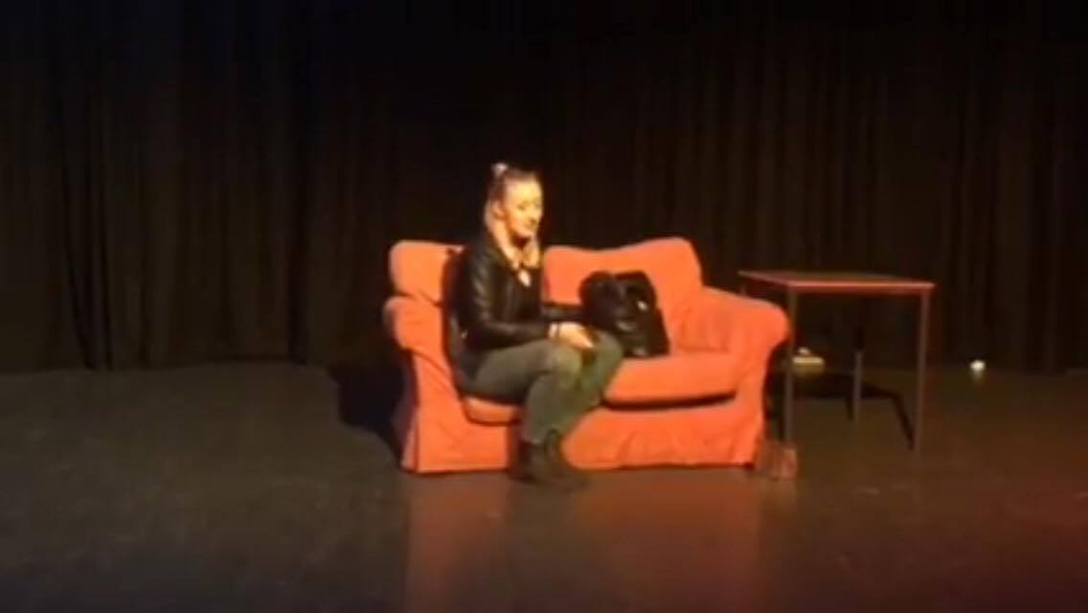
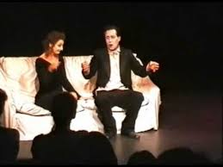
Characterisation
Will you use naturalistic or non-naturalistic techniques to create your character?
Or a Synthesis of both?

Slide 3
Creating a character
For your character explore these techniques to enhance the comedy character.
Centres of leading
Animal traits
Levels of tension
Music dynamics
How can you increase the pace?
Annotate your script

Slide 4
A Naturalistic approach
These are some ideas to create a believable and truthful character

Slide 5
Techniques for creating a naturalistic Character
Inner Monologue
Total life of the character
Music Dynamics
Actioning (Max Stafford Clarke)
Status improvisation
Off text improvisation
On text improvisation
Hot seating
Role on the wall
Line feeding
Experiment with several interpretations
Circle of life
Exploring staging options– set and costume
Chair exercise
Walking the arc of the text

Slide 6
A Naturalistic approach Applying Stanislavski techniques - Monologues
Magic if
Emotion Memory
Given Circumstances
Units /objectives/super-objective/Obstacles

Slide 7
The Magic If
The ‘magic if’ is imagination; for example, ‘If this piece of paper is a baby bunny rabbit then why is it here? Does it have siblings? Where are its parents?
The magic if encourages the mind to ask questions which will in turn give you the belief you need to provide more detail, build on ‘given circumstances’.
Your scriot already provide you with some facts- the given circumstances.
You now need to use your imaginations to fill in the blanks.

Slide 8
Non-Naturalistic approach
These are some ideas for alternative ways into your monologue

Slide 9
Toolkits
Tension toolkit
Comedy toolkit
Vocal toolkit
Physical toolkit

Slide 10
Non-naturalistic performance
Non-naturalistic Drama is acting away from the normal ways that people are used to. For example, talking or walking in a weird, unusual manner that is not representative of real life.
Non-naturalism does not seek to re-create life as it is lived, but is focused more on passing comment on, or responding to, aspects of the real world. Non-naturalistic performance can occur in any space and is not dependent on specific resources. Non-naturalistic performance work might include the manipulation of both naturalistic and non-naturalistic conventions.

Slide 11
Non-naturalistic performance
Non-naturalistic Drama is acting away from the normal ways that people are used to. For example, talking or walking in a weird, unusual manner that is not representative of real life.
Non-naturalism does not seek to re-create life as it is lived, but is focused more on passing comment on, or responding to, aspects of the real world. Non-naturalistic performance can occur in any space and is not dependent on specific resources. Non-naturalistic performance work might include the manipulation of both naturalistic and non-naturalistic conventions.

Slide 12
Non-naturalistic techniques
Narration
Narration is a technique whereby one or more performers speak directly to the audience to tell a story, give information or comment on the action of the scene or the motivations of characters. Characters may narrate, or a performer who is not involved in the action can carry out the role of 'narrator'. Consider the opening scene of Henry V in which ‘Chorus’ introduces the audience to the play and outlines what is happening - and then reappears at points in the play to describe the change of scene.
Mime
A complex and sophisticated art-form in itself - but useful at all levels especially where staging is minimal or non-existent.

Slide 13
Non-naturalistic techniques
Breaking the Fourth Wall
A good reason to know what the Fourth Wall is - remember a week or so ago? - is consider it being broken (eg in a pantomime where the actors may ask the chilren in the audience for help as they look for the villain…”He’s behind you…”). ie speaking directly to the audience as if stepping momentarily out of they play. Woody Allen does this a lot: watch ‘Annie Hall’ if you haven’t already.
Split Scene
This is where two scenes go on at the same time on stage, one stage left and one stage right. The scene stage left will begin, for example and the actors in the scene stage right will be frozen. The actors stage left will then freeze and the actors stage right will resume the action and then freeze at the end. This may go backwards and forwards several times. It is used to show events that are taking place simultaneously

Slide 14
Non-Naturalistic techniques
Marking the Moment
Is just a term used to identify where one of the strategies above has been used to draw particular attention to a point in the drama. eg using slow motion and exaggeration to highlight a key point in a murder scene?
Flashback
Familiar from film, television and literature. It can be done in a number of ways - eg. an old man on one side of the stage thinks back to events in childhood, played by another, presumably younger actor while he watches on as if watching his own earlier life. Flash forward also possible.

Slide 15
How can we create a character? Which of these techniques suit non naturalistic theatre?
Stanislavski – emotion memory, given circumstances, magic if, units and objectives
Brecht –direct address, gestus, thoughts aloud
Physicality – centres of leading, centres of personality, levels of tension, animal traits
Stylised – Grid, slow motion, Meyerhold
Vocal – tone pitch intonation

